Slide 1
Superstore Sales & Profit Analysis Dashboard
Interactive Business Dashboard using Tableau
Prepared by: Vanshika Gupta
Role: Data Analytics Intern

Slide 2
Project Overview
Objective: To analyze Superstore sales data and build an interactive Tableau dashboard to understand business performance and key drivers.
Key Focus Areas:
Tracking overall Sales and Profit metrics.
Analyzing monthly Sales and Profit trends.
Evaluating Category and Sub-Category performance.
Understanding Regional performance and Customer Segments.

Slide 3
Dataset & Tools
Dataset Used: Superstore Sales Dataset.
Key Fields: Order Date, Sales, Profit, Quantity, Category, Sub-Category, Region, Segment.
Tools Used:
Tableau Desktop / Tableau Public.
Excel / CSV Dataset.
Dashboard Features: KPI Cards, Line Charts, Bar Charts, Dynamic Filters.

Slide 4
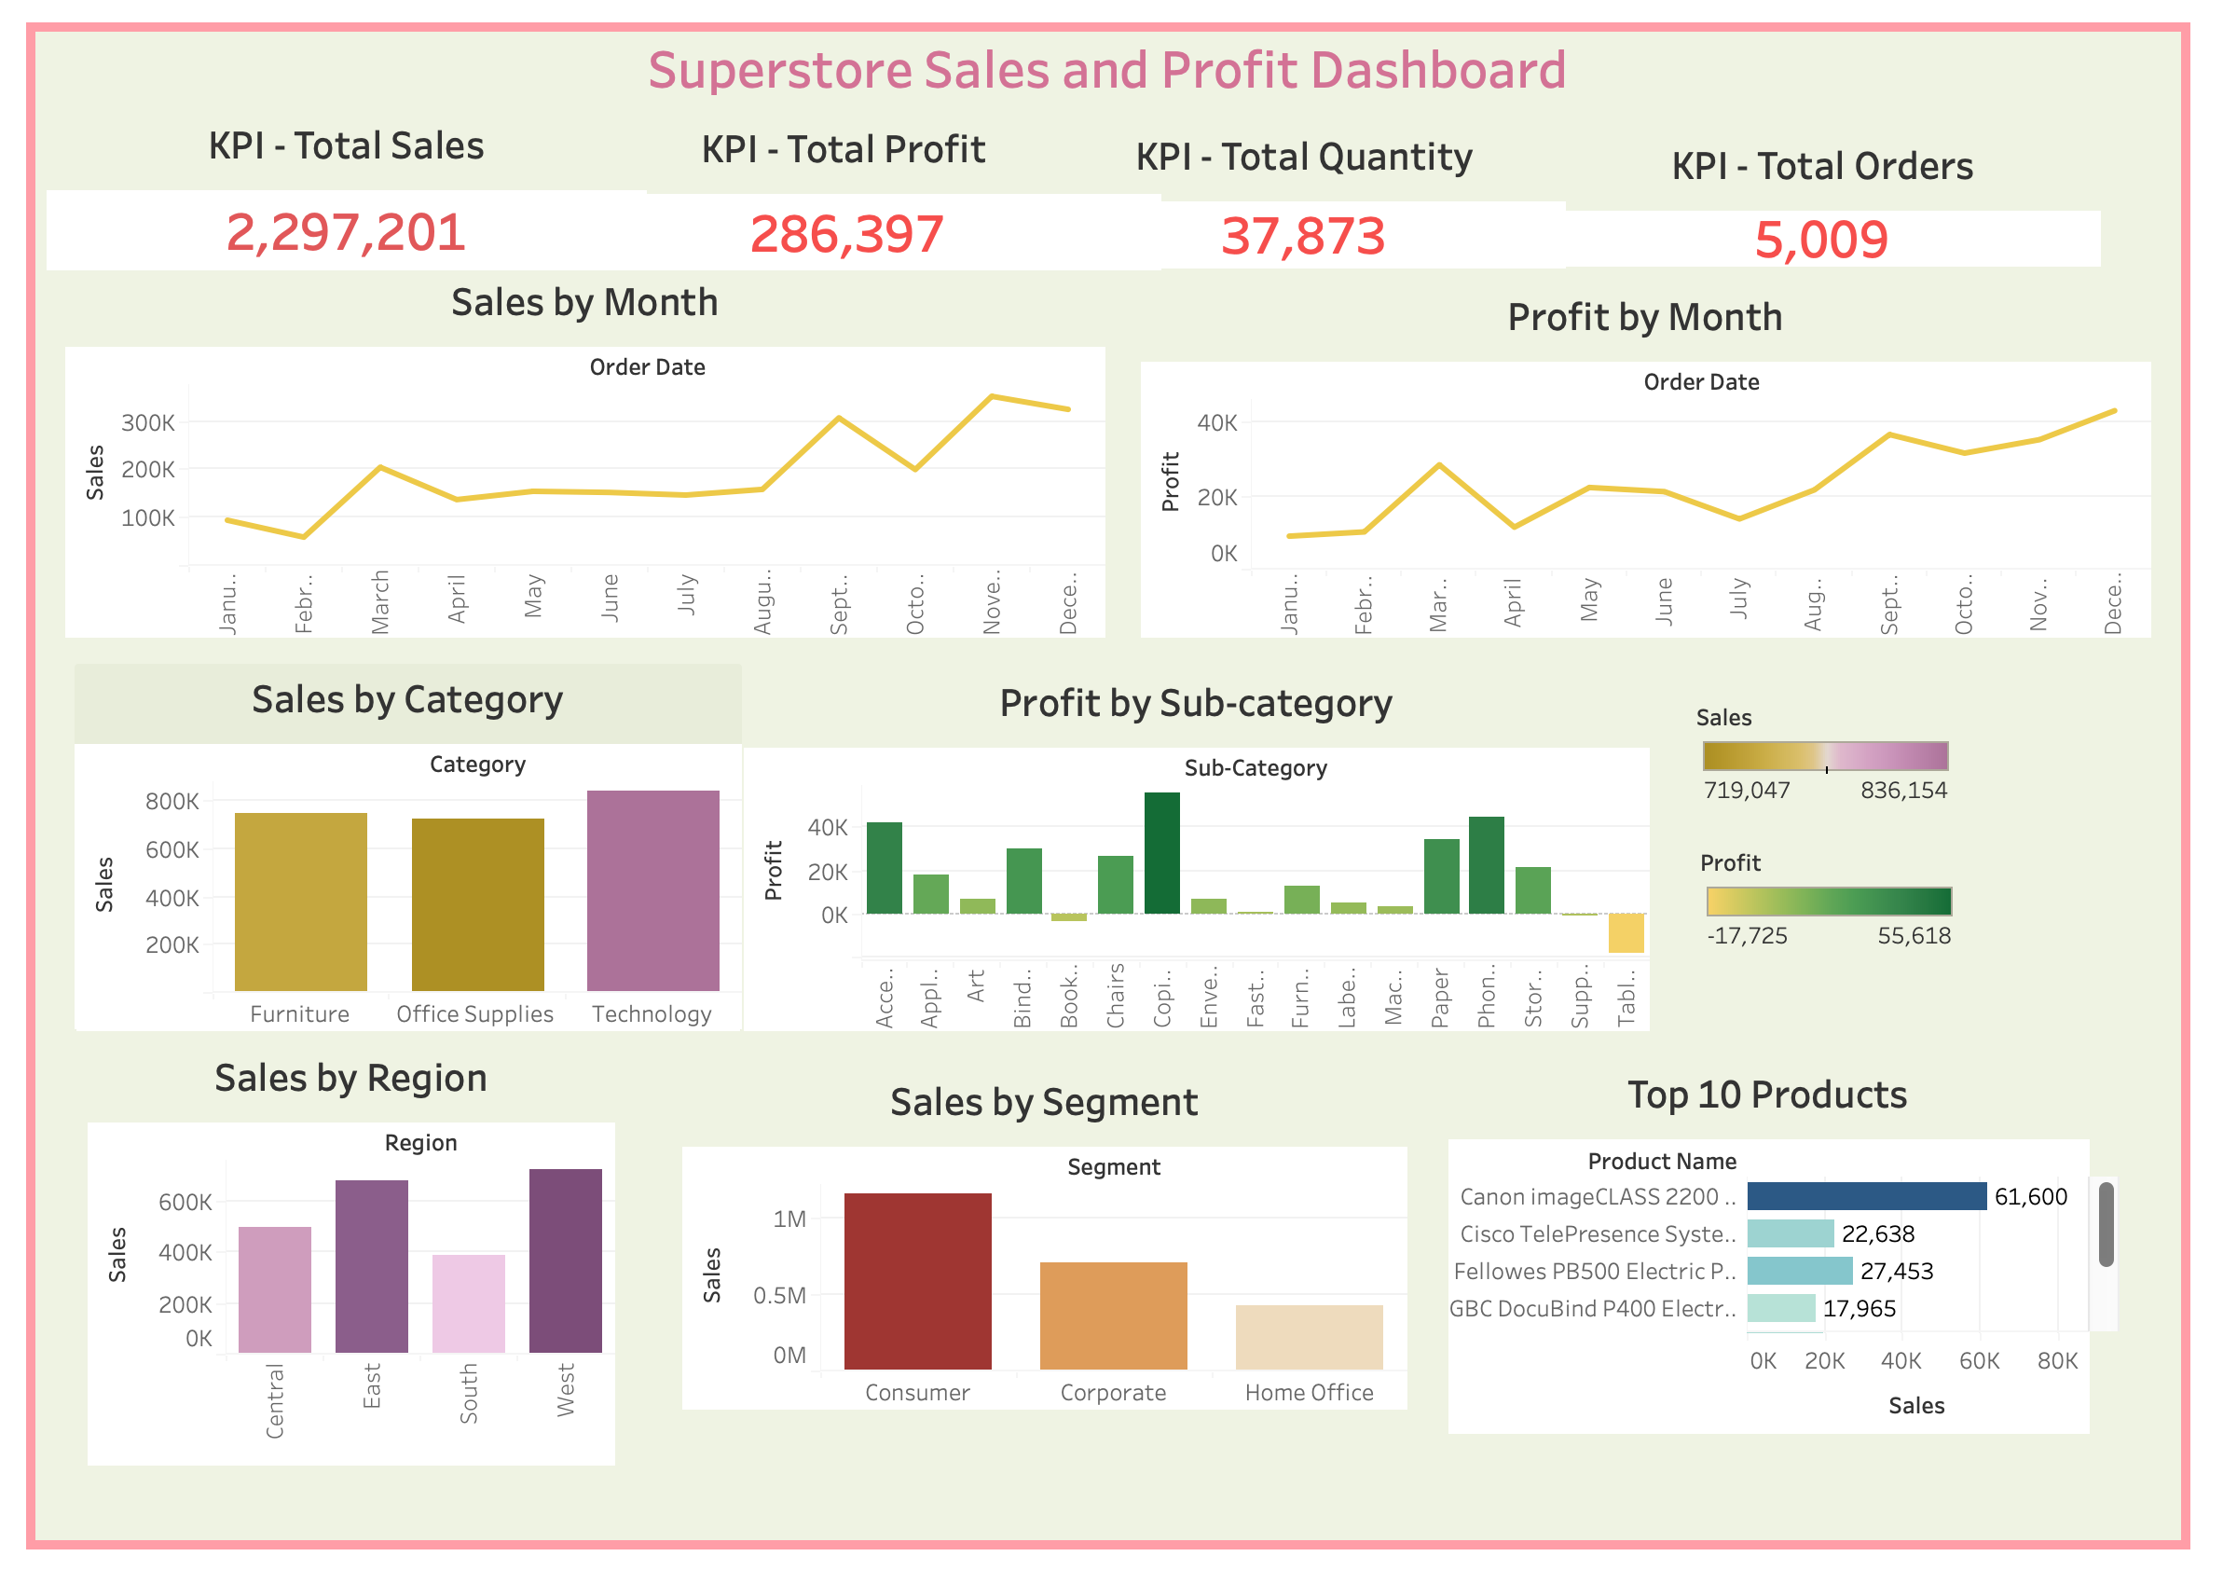
Superstore Sales & Profit Performance Dashboard

Slide 5
Key Insights
Overall Metrics: The business generated total Sales of 2,297,201 and a Net Profit of 286397. Total Quantity sold reached 37,873 across 5,009 total orders.
Monthly Trends: Sales show a strong seasonal spike toward year-end (November & December), while starting slower in the first quarter.
Category Performance: Technology leads as the top revenue-generating category, followed by Office Supplies and Furniture.
Profitability: Some sub-categories generate high sales volume but yield lower profit margins or losses due to heavy discounting (e.g., Tables).
Regional Breakdown: The West region leads in overall sales performance, while other regions show distinct growth opportunities.

Slide 6
Recommendations & Conclusion
Recommendations:
Focus on High-Margin Products: Prioritize marketing for categories and sub-categories with higher profit returns.
Review Discount Strategies: Adjust pricing and discount policies on low-profit items (e.g., Tables) to prevent profit loss.
Capitalize on Q4 Demand: Plan inventory and logistics well in advance to handle year-end seasonal demand spikes.
Conclusion:
The interactive Tableau dashboard provides clear visibility into Superstore's overall sales performance, helping stakeholders identify key trends, profitable product segments, and actionable growth opportunities.

